Slide 1

ENGINEERING CHEMISTRY
Asha A
Department of Science and Humanities

Slide 2

ENGINEERING CHEMISTRY
Module 5- Energy storage devices – Oxygen sensor
Class content:
Oxygen sensor
Applications
Oxygen sensor in automobiles
Principle
Construction and working

Slide 3
ENGINEERING CHEMISTRY
Module 5- Energy Storage devices- Oxygen sensor
Oxygen sensor
An electronic device that measures the proportion of O₂ in the gas or liquid being analysed
Applications of O₂ sensor:
Divers use to measure partial pressure of O₂ in their
breathing gas
Scientists use as probes to measure respiration or
production of O₂
O₂ analyzers used in medical applications such as anesthesia
monitors, respirators etc
Used to measure exhaust gas concentrations of O₂ in IC
engines

Slide 4
ENGINEERING CHEMISTRY
Module 5- Energy Storage devices- Oxygen sensor
Role of oxygen sensor in automobiles
Principle :
Stoichiometric air/fuel ratio ideal for combustion of gasoline is 14.7:1
Located in the exhaust stream and indirectly determine air to fuel ratio
O₂ sensor allows engine control system to maintain ideal ratio across various engine operating systems
It compares the amount of O₂ in the exhaust to the amount of O₂ in the atmosphere

Slide 5
ENGINEERING CHEMISTRY
Module 5- Energy Storage devices- Oxygen sensor
An output voltage is generated based on the difference in O₂ concentration in the exhaust and atmosphere
An output voltage of 0.2V represents a lean mixture and 0.8V represents a rich mixture
Ideal set point is around 0.45 V
The voltage is sent as feedback to Engine control unit which adjusts the air/fuel ratio back to stoichiometric value
Lean mixture results in more of NO_{X} emissions
Rich mixture leads to more of CO , C particles and unburnt
fuel emissions
Based on solid state electrochemical fuel cell
Operates at a minimum temperature of 360ºC

Slide 6
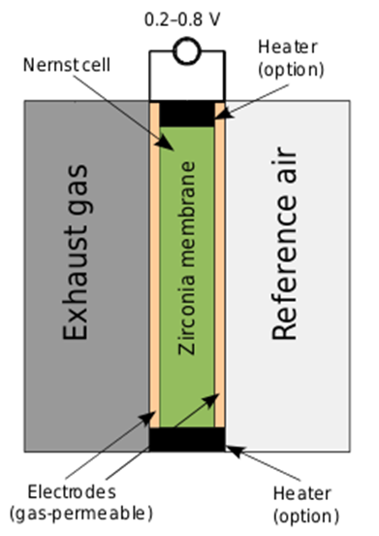
ENGINEERING CHEMISTRY
Module 5- Energy Storage devices- Oxygen sensor
Construction:
Anode : Pt
Cathode : Pt
Electrolyte : Zirconium oxide (ZrO₂ )
doped with Yttrium oxide (Y₂O₃ )

Slide 7

ENGINEERING CHEMISTRY
Module 5- Energy Storage devices- Oxygen sensor
Working :
Cell voltage is given by
where P₁ and P₂ are the partial pressures of O₂ in
reference air and exhaust gas respectively

Slide 8
ENGINEERING CHEMISTRY
Module 5- Energy Storage devices- Oxygen sensor
Automobiles fitted with O₂ sensor must use unleaded
gasoline as lead poisons the Pt catalyst and reduces its
efficiency
Symptoms of failure are – increased tail pipe emissions,
increased fuel consumption and hesitation on acceleration

Slide 9
ENGINEERING CHEMISTRY
Module 6- Electrochemical Sensors
Class Content :
GLUCOSE SENSOR
Components of glucose biosensor
Working of glucose biosensor
Limitations

Slide 10
ENGINEERING CHEMISTRY Module VI- Electrochemical Sensors
Blood Glucose Monitoring
Blood Glucose Monitoring is a way of checking the concentration of glucose in the blood using a glucometer.
Provides quick response to tell if the sugar is high or low indicating a change in diet, exercise or insulin.
Over time, it reveals individual of blood glucose changes.

Slide 11
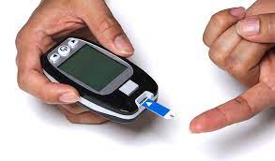
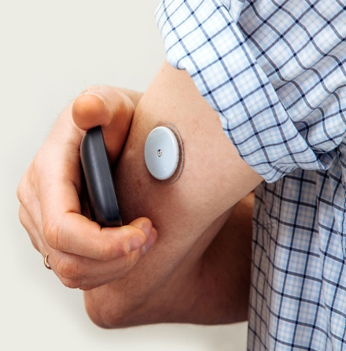
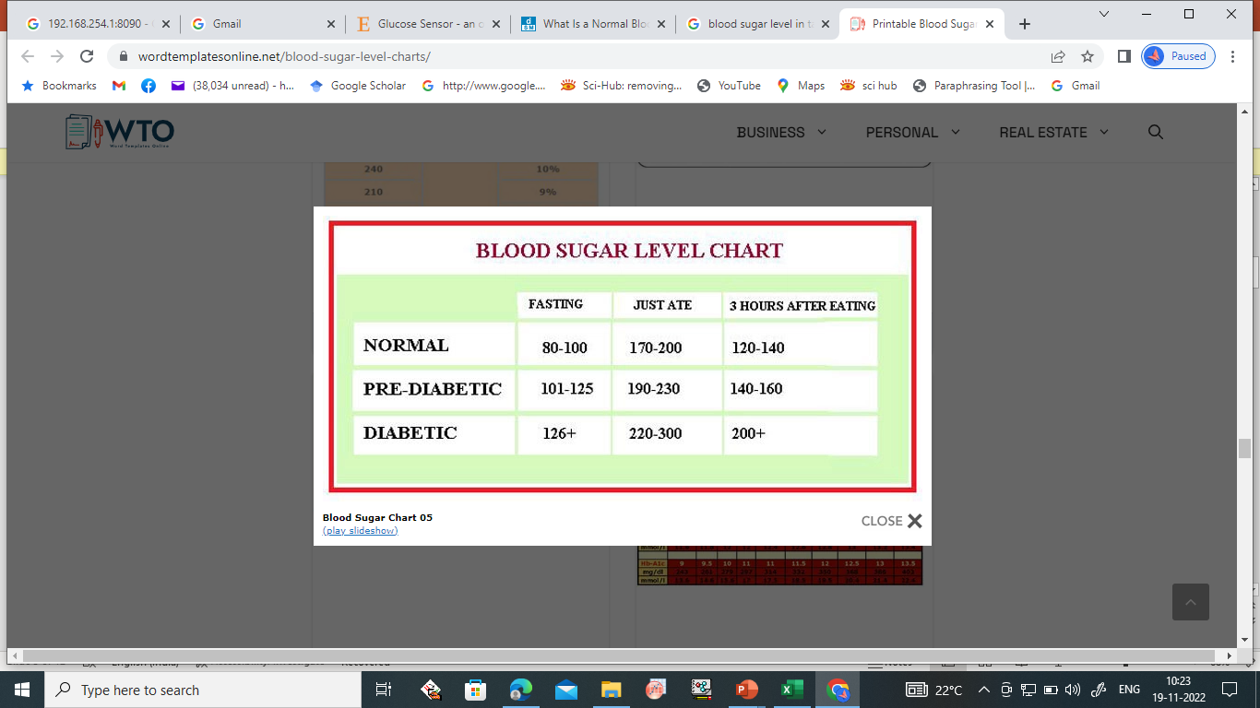
Why Monitor Blood Glucose?
ENGINEERING CHEMISTRY
Module VI- Electrochemical Sensors
Reduces risk of developing complications with diabetes.
Allows diabetics to see if the insulin and other medications they are taking are working.
Gives diabetics an idea as to how exercise and food affect their blood sugar.
May prevent hypoglycemia or hyperglycemia

Slide 12
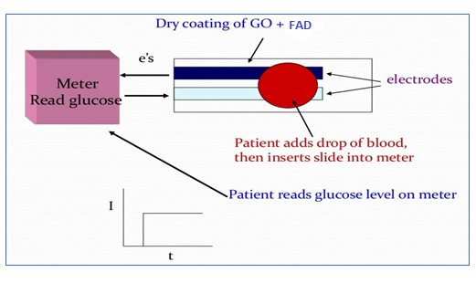
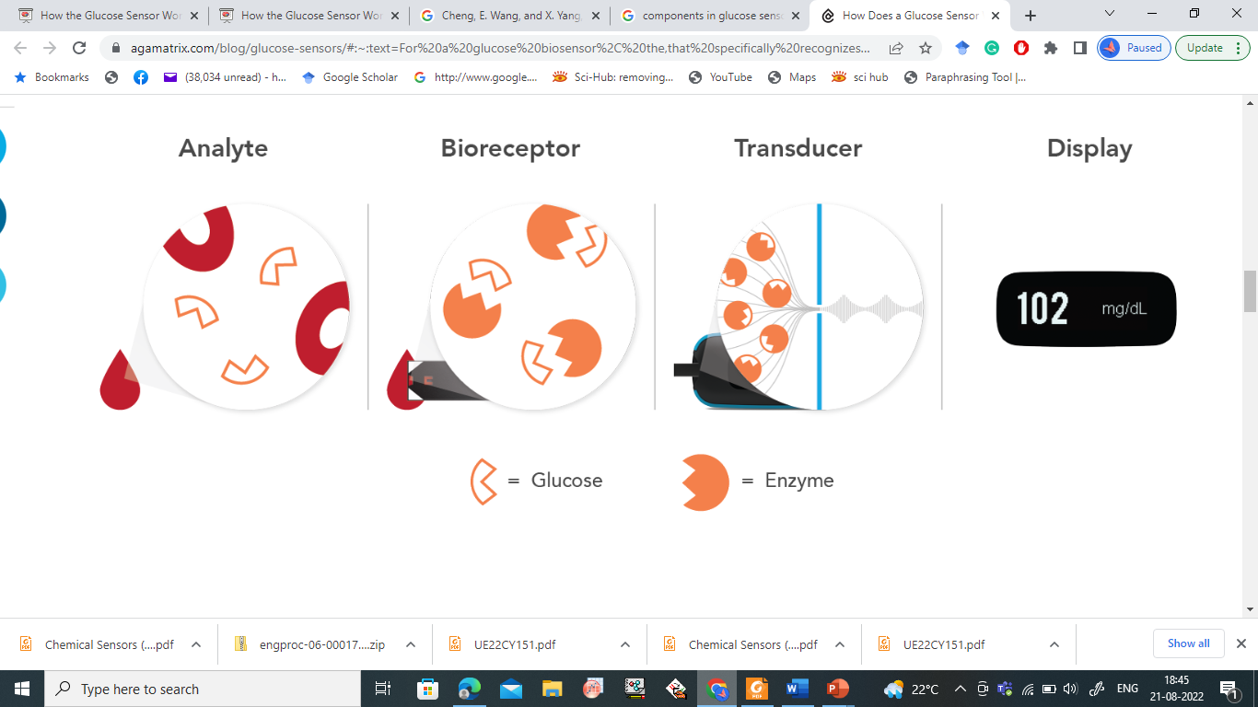
ENGINEERING CHEMISTRY
Module 6- Electrochemical Sensors
Components of Glucose Sensor
Analyte
Bioreceptor
Transducer
Electronics and display

Slide 13
ENGINEERING CHEMISTRY Module VI- Electrochemical Sensors
Working of Glucose Biosensor
Developed by Updike and Hicks
Enzyme Glucose oxidase(GOx) catalyze the oxidation of glucose by molecular oxygen producing glucolactone and hydrogen peroxide.
In order to work as a catalyst, GOx requires a redox cofactor –flavin adenine dinucleotide (FAD), works as an initial electron acceptor and is reduced to FADH₂.
Glucose + GOx –FAD⁺ → Glucolactone + GOx – FADH₂

Slide 14
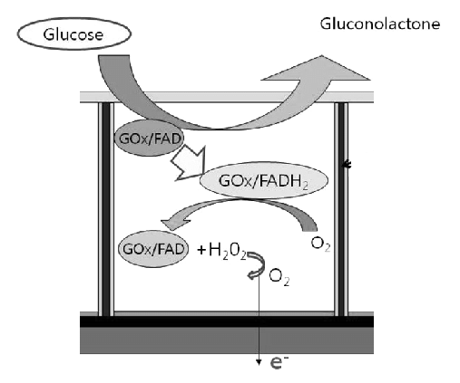
ENGINEERING CHEMISTRY
Module VI- Electrochemical Sensors
Working of Glucose Biosensor
The cofactor is regenerated by reacting with oxygen, leading to the formation of hydrogen peroxide
GOx – FADH₂ + O₂ → GOx – FAD + H₂O₂
Hydrogen peroxide is oxidized at a platinum electrode.
The number of electron transfers, at electrode surface is directly proportional to the number of glucose molecules present in the blood.
H₂O₂ → 2H⁺ +O₂ + 2e⁻

Slide 15
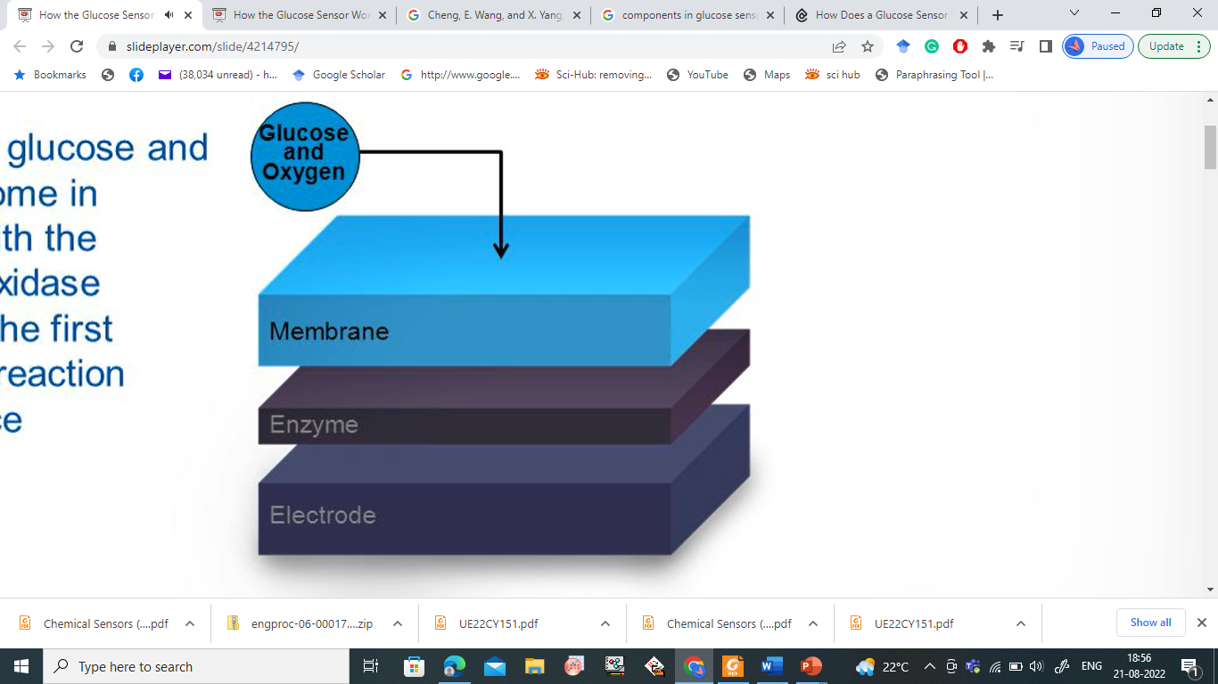
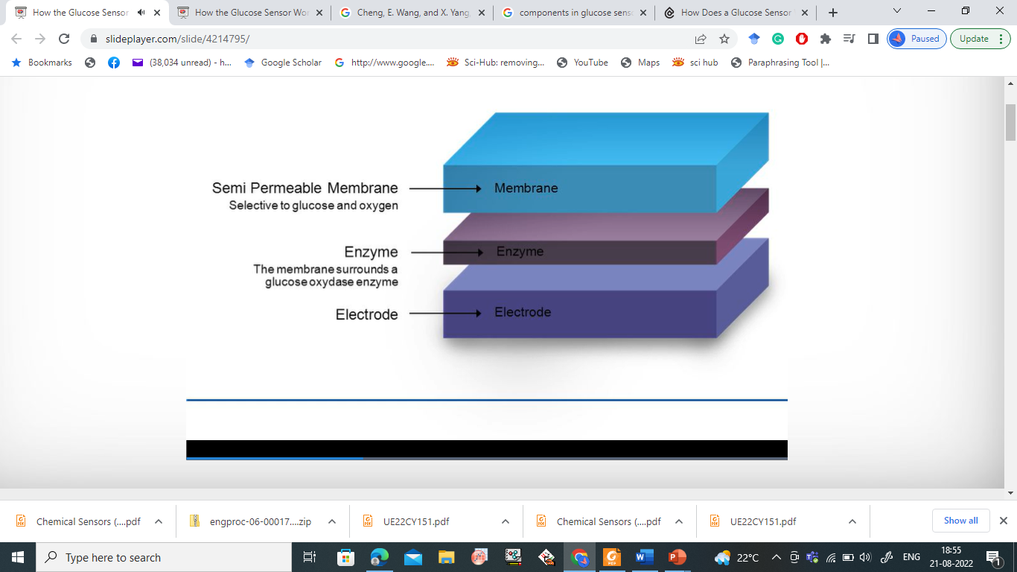
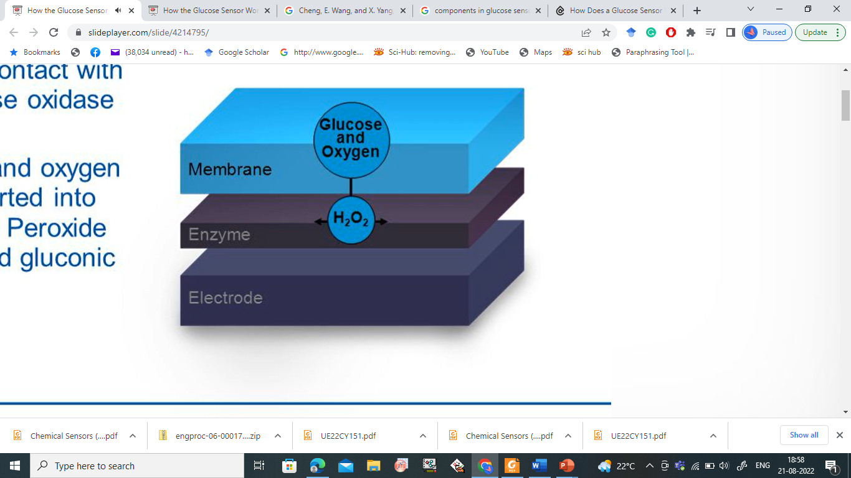
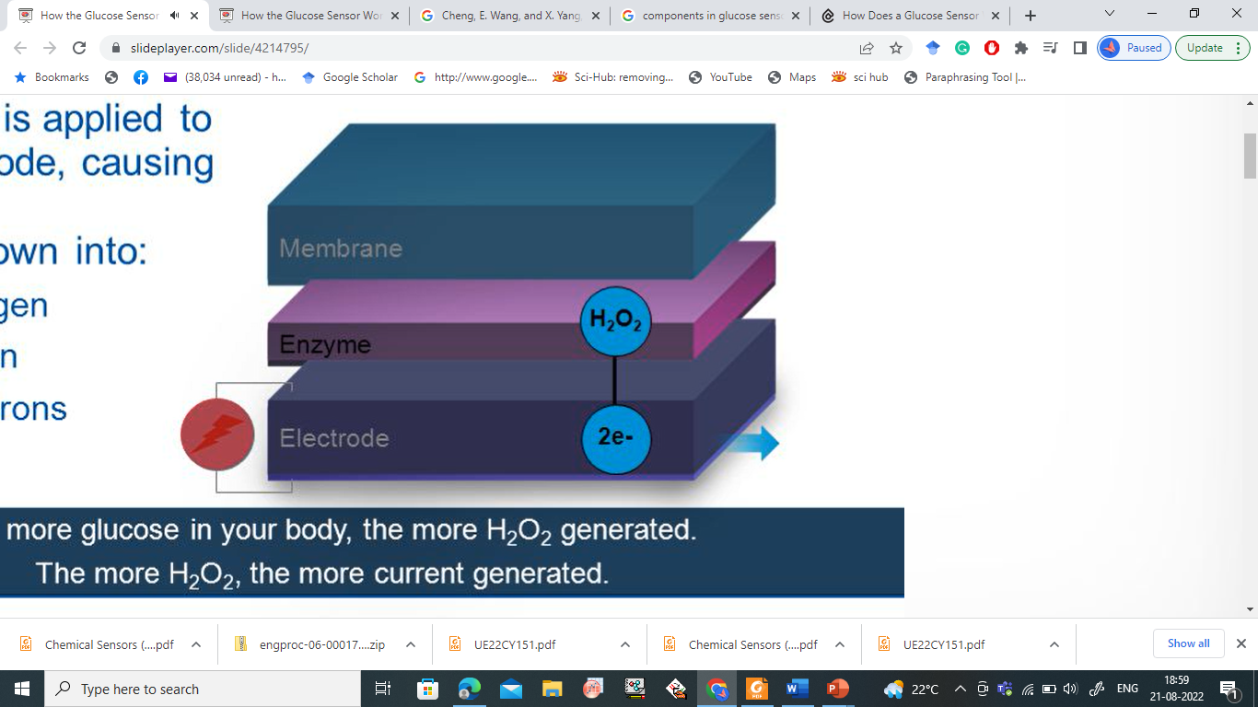
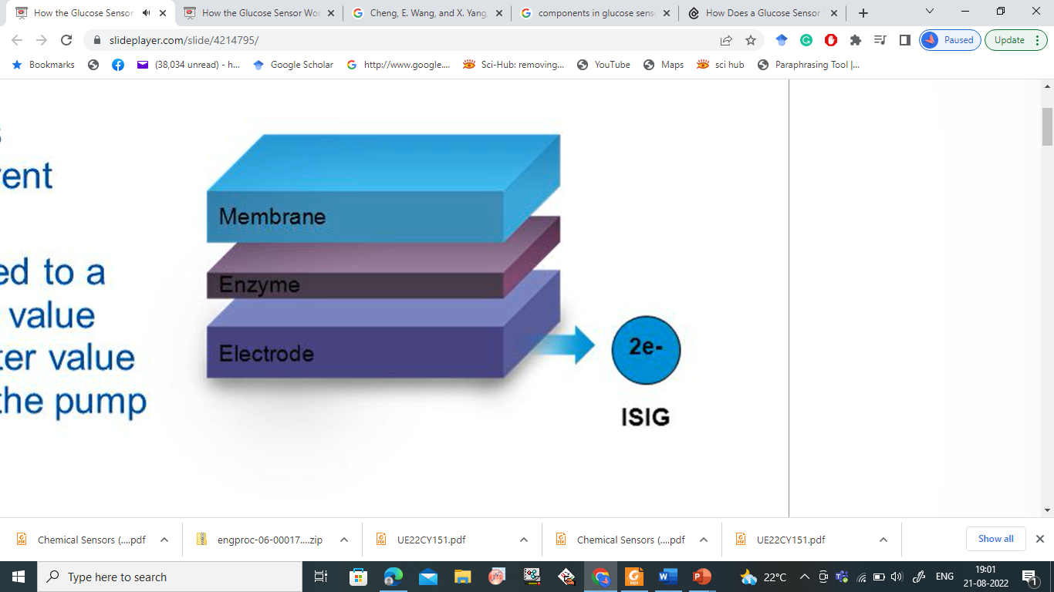
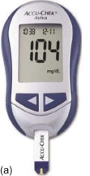
ENGINEERING CHEMISTRY
Module 6- Electrochemical Sensors
Working of Glucose Biosensor

Slide 16
ENGINEERING CHEMISTRY
Module VI- Electrochemical Sensors
Limitations of Glucose Sensors
Extreme environmental conditions like haematocrit values, or medication interferences may potentially falsify blood glucose readings.
Incorrect blood glucose readings may lead to treatment errors, for example, incorrect insulin dosing.

Slide 17
THANK YOU
Asha A
Department of Science and Humanities

